Slide 1

HIGH CLOUD AIRLINES
PROJECT [P638]
​

Slide 2
CONTENTS
Introduction
objective
Business Overview
Project Scope
Data Exploration And Cleaning
Data Modelling
Dashboards
Kpi Wise Observations
Recommendations
Conclusion

Slide 3

INTRODUCTION
"To revolutionize the airline industry through data-driven insights and optimization" High Cloud Airline, a leading player in the aviation sector, has been at the forefront of providing seamless air travel experiences.
Established with a commitment to excellence, High Cloud has consistently set industry standards in terms of reliability, safety, and customer satisfaction. Extensive network of routes spans across regions, connecting people and cultures, making High Cloud a preferred choice for millions of travelers globally.
High Cloud embraces innovation and modern technology to enhance operational efficiency and stay at the forefront of the aviation landscape.

Slide 4

OBJECTIVE
To gain a comprehensive understanding of "High Cloud Airlines" operations through data analysis. This will involve investigating load factors, identifying top carrier names based on passenger preference, analyzing popular routes, and exploring other key metrics. The ultimate goal is to provide actionable recommendations that can enhance operational efficiency and profitability.

Slide 5
Project Overview: In today’s competitive airline industry, data analysis plays a critical role in optimizing operations and maximizing profitability. By harnessing the power of data, High Cloud Airlines can gain valuable insights into various aspects of its business, allowing them to make data-driven decisions that can lead to Improved load factor Enhance Passenger Experience Optimized resource allocation Data –Driven Decision Making
BUSINESS OVERVIEW

Slide 6
The Project aimed to leverage the power of data analysis and extract valuable insights to optimize high cloud airline operations and performance. The specific scope of the project focused on analyzing key performance indicators (KPIs) to gain deeper understanding of: • Load Factor • Passenger Preferences • Popular Routes • Operational Efficiency.
PROJECT SCOPE

Slide 7
Data Exploration and cleaning: The analysis is based on 8 CSV files, which are cleaned and manipulated to extract valuable insights.Identify missing and duplicate values in each dataset and treat them accordingly. Also treat all data quality issues associated with the dataset.
DATA EXPLORATION AND CLEANING

Slide 8
Throughout our analysis, we encountered various challenges in handling the data. Data Volume: Managing and Processing large datasets efficiently. Data Quality: Ensuring accuracy and reliability of the data. Complex Relationships: Establishing connections between different data points of the data. Data Merging: For Extracting Different kpi's we need to merge the datasets with the help of power query. Data Visualization: The data visualization for High Cloud Airlines highlights flight routes, passenger demographics, financial performance, and operational efficiency. Market analysis: The Project aimed to leverage the power of data analysis and extract valuable insights to optimize high cloud airline operations and performance.
DATA MODELLING

Slide 9

KPI WISE OBSERVATIONS

Slide 10
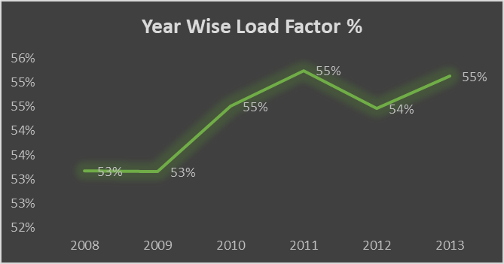
Find the load Factor percentage on a yearly, Quarterly, Monthly basis
Analyzed the load factor for each year. The load factor measures the percentage of available seating capacity filled with passengers.
A high load factor indicates a preferred airline with most seats sold.
The load factor showed growth after a stable phase in 2008-2009, peaking at 55% in 2010 and sustaining it with a slight fluctuation in 2012.
Despite a small dip, the trend indicates that the load factor is stabilizing around 55% toward the end of the period.

Slide 11
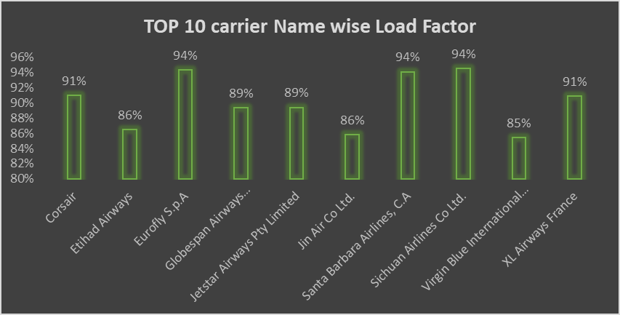
Find the load Factor percentage on a Carrier Name basis
Analyzed the total number of passengers traveling with each airline.
Identified the top 10 carrier names based on passenger count.
The three airlines with the 94% load factor dominate in terms of passenger capacity usage
There is a noticeable gap between the best performers (94%) and the lower end (85%-86%)

Slide 12
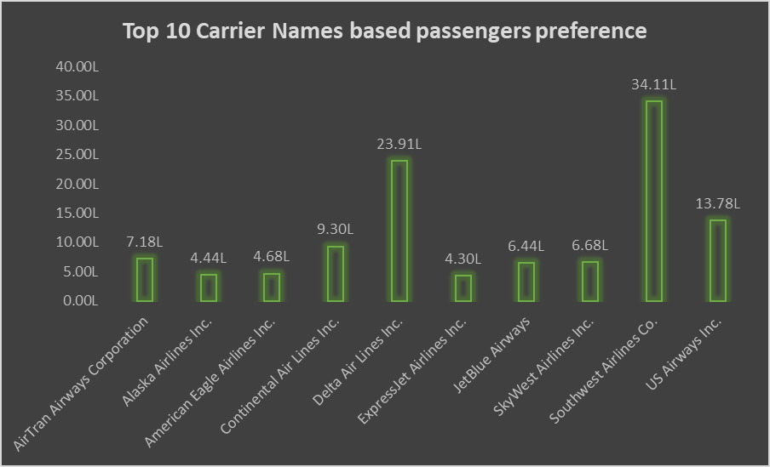
Identify Top 10 Carrier Names based passengers preference
Southwest Airlines Co. stands out significantly with the highest passenger count of 34.11L. This suggests it is the most preferred airline by a large margin.
Continental Air Lines Inc. and American Eagle Airlines Inc. have the fewest passengers, with 4.68L and 4.44L, respectively.
Southwest Airlines Co. is clearly the dominant carrier, with over 10 lakh more passengers than the second most preferred airline.
There is a wide disparity between the top and bottom airlines, with the lowest carrier having less than 15% of the top airline's passengers.

Slide 13
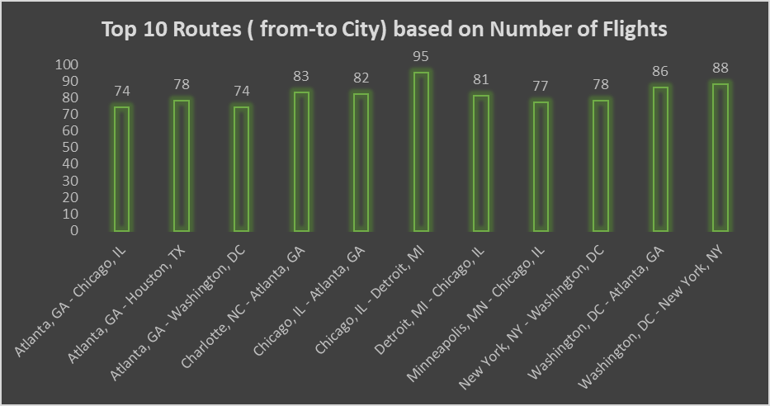
Display top Routes based on Number of Flight
This bar chart shows the top 10 most popular flight routes based on the number of flights.
The data is sorted in descending order, with the most popular route being Atlanta, GA to Chicago, IL with 95 flights.
The data also shows that Atlanta, GA is a popular origin city for flights, with three routes in the top 10. The data suggests that the top 10 flight routes are primarily within the United States.

Slide 14
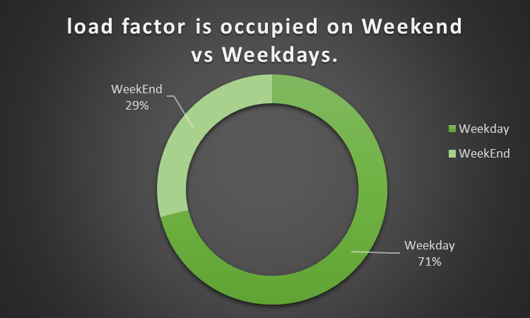
Identify the how much load factor is occupied on Weekend vs Weekdays.
The pie chart shows that the load factor is occupied on Weekdays 71% of the time and on Weekends 29% of the time.
This suggests that the load factor is more heavily used during the week, possibly due to factors such as business hours or school schedules.
It is worth noting that the Weekday load factor is more than double the Weekend load factor. Further investigation could be conducted to determine the reason for this disparity.
This could include an analysis of the specific hours during the week and weekend when the load factor is being used, as well as any seasonal or cyclical patterns that might be present.

Slide 15
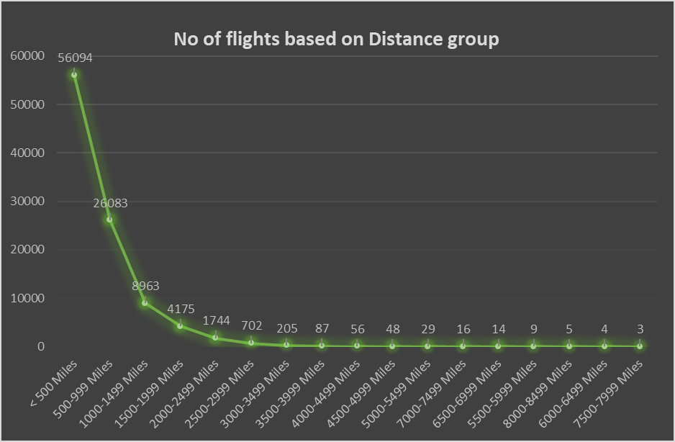
Identify number of flights based on Distance group
This KPI shows the number of flights based on distance group. We can see that the number of flights decreases as the distance increases. This is likely because:
Shorter flights are more common: People are more likely to take shorter flights for business trips, leisure travel, or visiting family and friends.
Cost: Longer flights are more expensive, both for airlines and passengers.
Time: Longer flights take more time, which can be a deterrent for some travelers.
The data also shows that the number of flights drops off sharply after 1,000 miles, and continues to decline at a more gradual rate. This suggests that there are more factors at play than just the distance itself. For example, there may be fewer destinations that are further away, or there may be more competition from other transportation modes such as trains or buses.
Overall, this data provides insights into the travel patterns of people, and how these patterns are influenced by factors such as distance, cost, and time.

Slide 16
DASHBOARDS

Slide 17
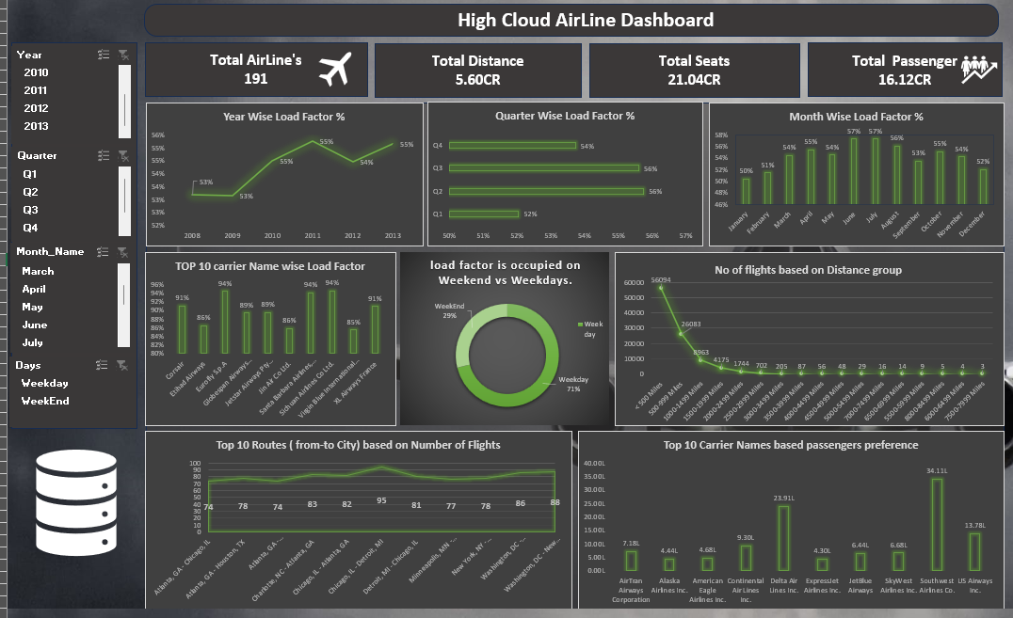
EXCEL DASHBOARD

Slide 18
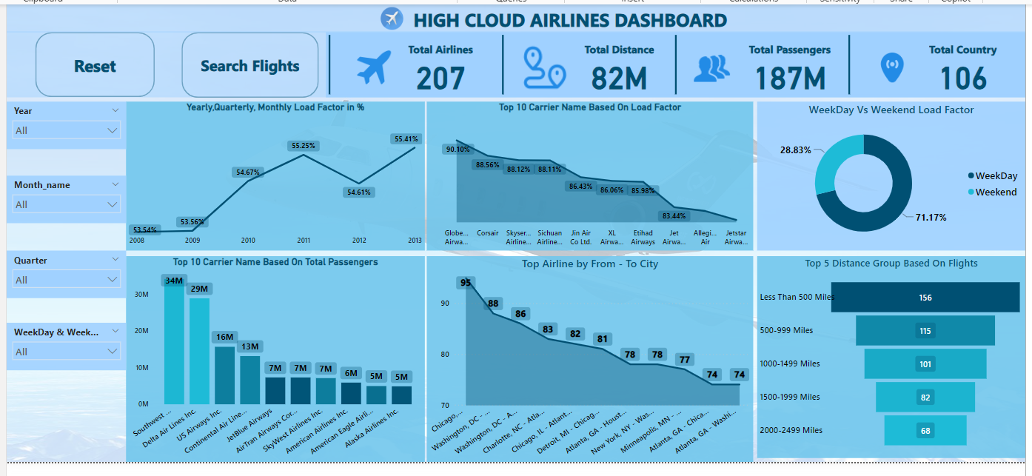
POWER BI DASHBOARD

Slide 19
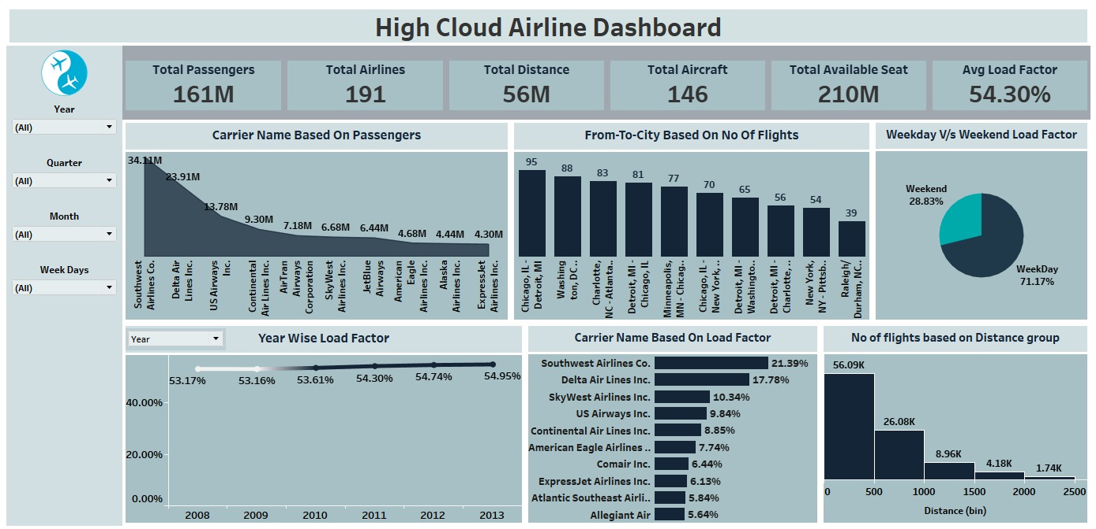
TABLEAU DASHBOARD

Slide 20
Optimize Fight Routes: Utilize insight from up routes and flights to Optimize schedule and resource allocation. Enhance Load Factor: Average load factor analysis to identify trends and implement strategies for increased efficiency. Stratergic Carrier Partnership: Collaborate with top carriers to maximize passenger transportation and enhance overall performance. Resourse Allocation: Allocate resources strategically based on flight schedules and passenger volume data.
KEY INSIGHTS

Slide 21
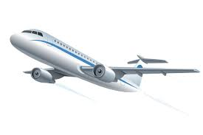
RECOMMENDATIONS
• Optimize Fight Routes: Utilize insights from up routes and flights to Optimize schedule and resource allocation.
• Enhance Load Factor: Leverage load factor analysis to identify trends and implement strategies for increased efficiency. Stratergic Carrier Partnership: Collaborate with top carriers to maximize passenger transportation and enhance overall performance.
• Resourse Allocation: Allocate resources strategically based on flight schedules and passenger volume data. This ensures efficient operation and minimizes wait times at airports with high passenger traffic.

Slide 22

CONCLUSION
High Cloud Airlines empowers the aviation industry with actionable insights, foresting efficiency, and strategic decision-making. The presented KPIs offer a glimpse into the vast potential for improvement and growth within the industry. By harnessing the power of data, we can drive positive changes, ensuring a bright future for High Cloud Airlines and its partners in the aviation sector.

Slide 23

THANK YOU

